Slide 1
GR 5243 Applied Data Science
Project 4 Algorithm Implementation and Evaluation
Yu, Chenghao (cy2475)
Team Members:
Chen, Jannie (mc4398) Chen, Sizhu (sc4248) Li, Yunfan (yl3838) Xu, Zhengyang (zx2229)

Slide 2
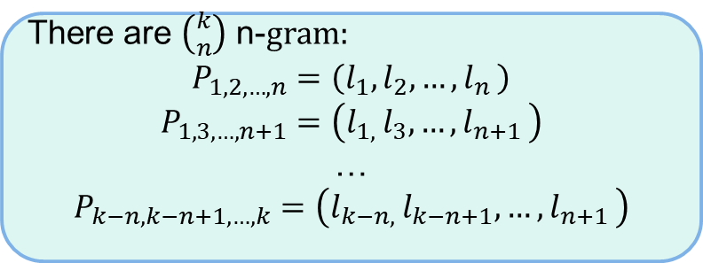
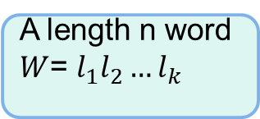
Detection: Binary n-Grams Method (D-2)
Idea:
Check whether letter pairs in the word at different positions exists in ground truth. If any pairs of letters are not in ground truth, the word is detected as error.
Concepts:
n-Grams
There are $\left({k \atop n}\right)$ n-$gram:$
$$P_{1,2,…,n}=\left(l_{1},l_{2},{…,l}_{n}\right)$$
$$P_{1,3,…,n+1}=\left(l_{1, }l_{3},{…,l}_{n+1}\right)$$
…
$$P_{k−n,k−n+1,…,k}=\left(l_{k−n, }l_{k−n+1},{…,l}_{n+1}\right)$$
A length n word $W$= $l_{1}l_{2}{…l}_{k}$

Slide 3
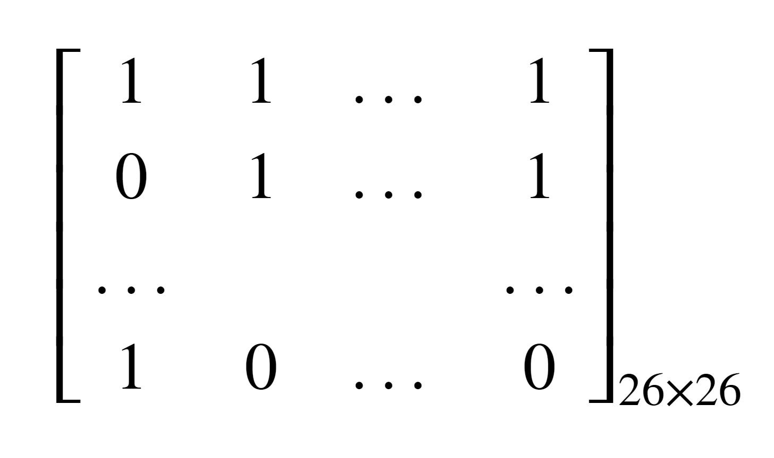
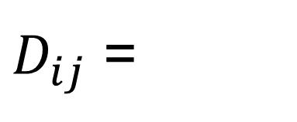
Detection: Binary n-Grams Method (Cont.)
Binary 2-gram Matrix:
a b … z
a b … z
$D_{ij}$ =

Slide 4
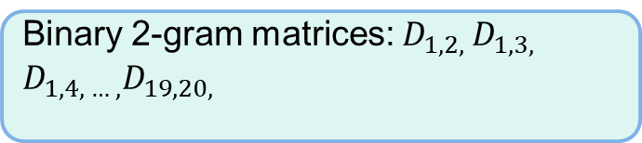
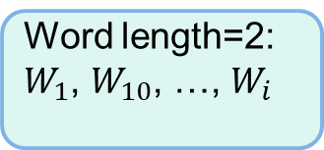



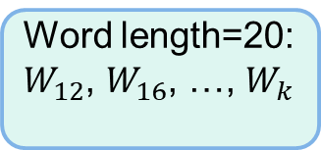
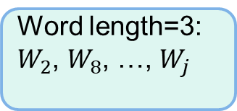
Detection: Binary n-Grams Method (Cont.)
Creating Binary Matrices:
Create all binary 2-gram matrices
Word length=2:
$W_{1}$, $W_{10}$, …, $W_{i}$
Binary 2-gram matrices: $D_{12}$
Ground truth text:
$W_{1}$, $W_{2}$, …, $W_{n}$
Word length=3:
$W_{2}$, $W_{8}$, …, $W_{j}$
Binary 2-gram matrices: $D_{1,2, }D_{1,3, }$ $D_{2,3, }$
…
Word length=20:
$W_{12}$, $W_{16}$, …, $W_{k}$
Binary 2-gram matrices: $D_{1,2, }D_{1,3, }$ $D_{1,4, … ,}D_{19,20, }$

Slide 5
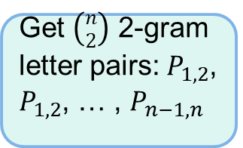
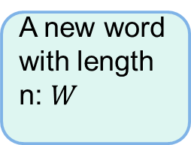
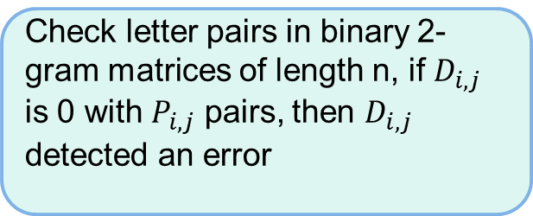
Detection: Binary n-Grams Method (Cont.)
Detection:
Check letter pairs in binary 2-gram matrices of length n, if $D_{i,j}$ is 0 with $P_{i,j}$ pairs, then $D_{i,j}$ detected an error
A new word with length n: $W$
Get $\left({n \atop 2}\right)$ 2-gram letter pairs: $P_{1,2}$, $P_{1,2}$, … , $P_{n−1,n}$
Find union set of the locations where detected the error happened, the result is the error location in the word.
Assumption:
Only one error in every ORC output word

Slide 6
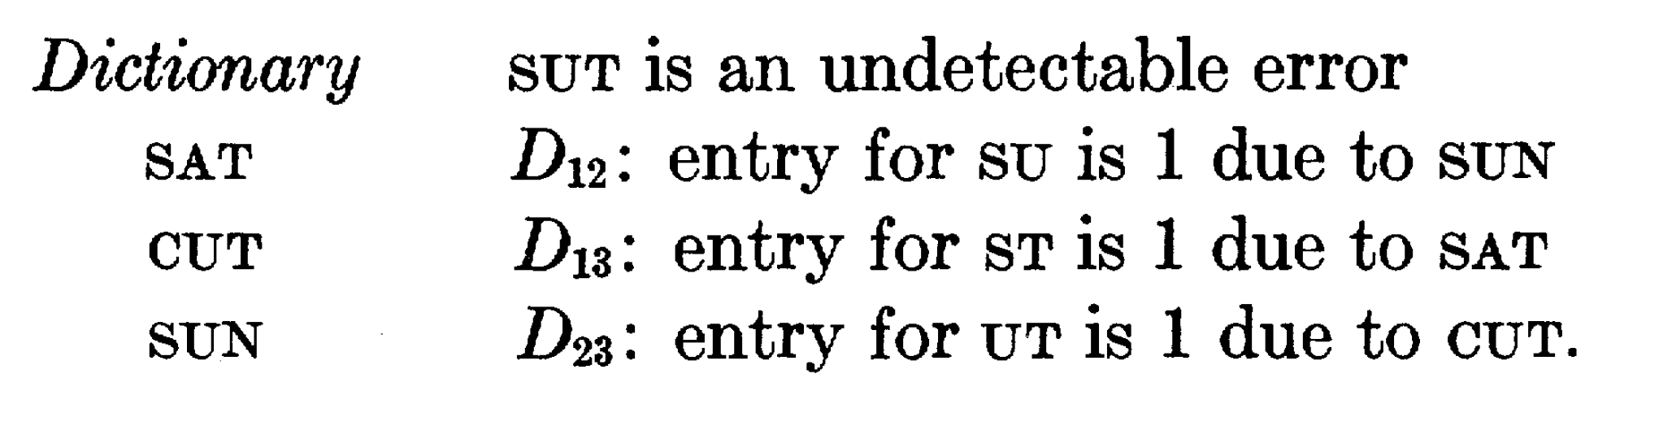
Detection: Binary n-Grams Method (Cont.)
Undetectable Case:

Slide 7
Detection: Binary n-Grams Method (Cont.)
Advantages:
Saving storage space
More efficient than dictionary based methods
Extendability
Disadvantages:
Theoretical Undetectable case
Lower detection rate than dictionary based methods
Cannot detecte errors in non-alphabetic languages

Slide 8
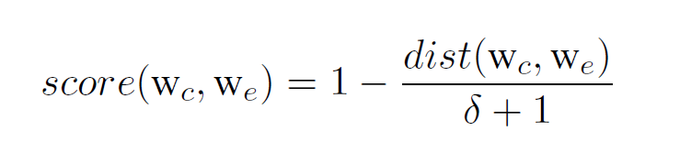
Correction: Statistical Learning Model (C-2)
Idea:
Using a regression model with six feature scores to predict the class of candidates.
Concepts:
Feature scores（some kinds of measurement of similarity between two strings):
Levenshtein edit distance score:

Slide 9
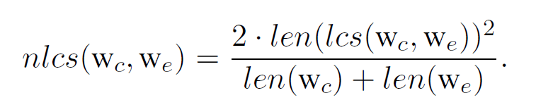
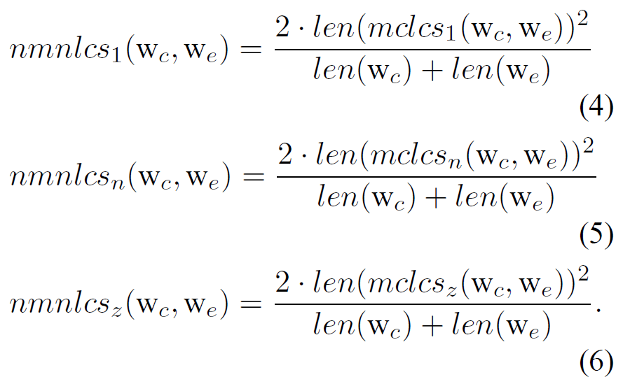
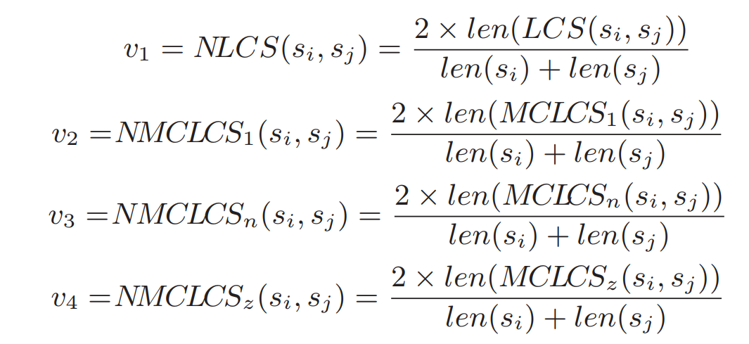
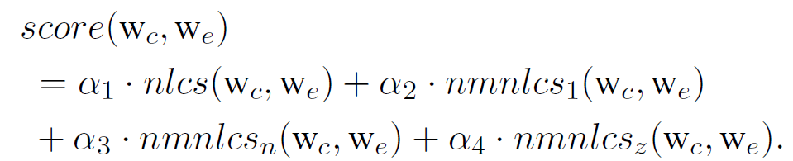
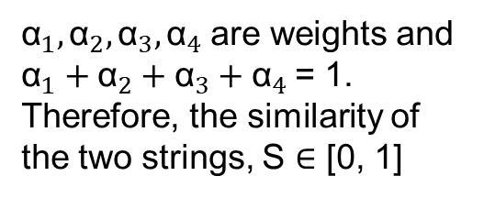
Correction: Statistical Learning Model (Cont.)
String similarity score:
C-2 paper:
Original paper:
${\text{α}}_{1},{\text{α}}_{2},{\text{α}}_{3},{\text{α}}_{4}$are weights and ${\text{α}}_{1}+{\text{α}}_{2}+{\text{α}}_{3}+{\text{α}}_{4}$= 1. Therefore, the similarity of the two strings, S ∈ [0, 1]

Slide 10
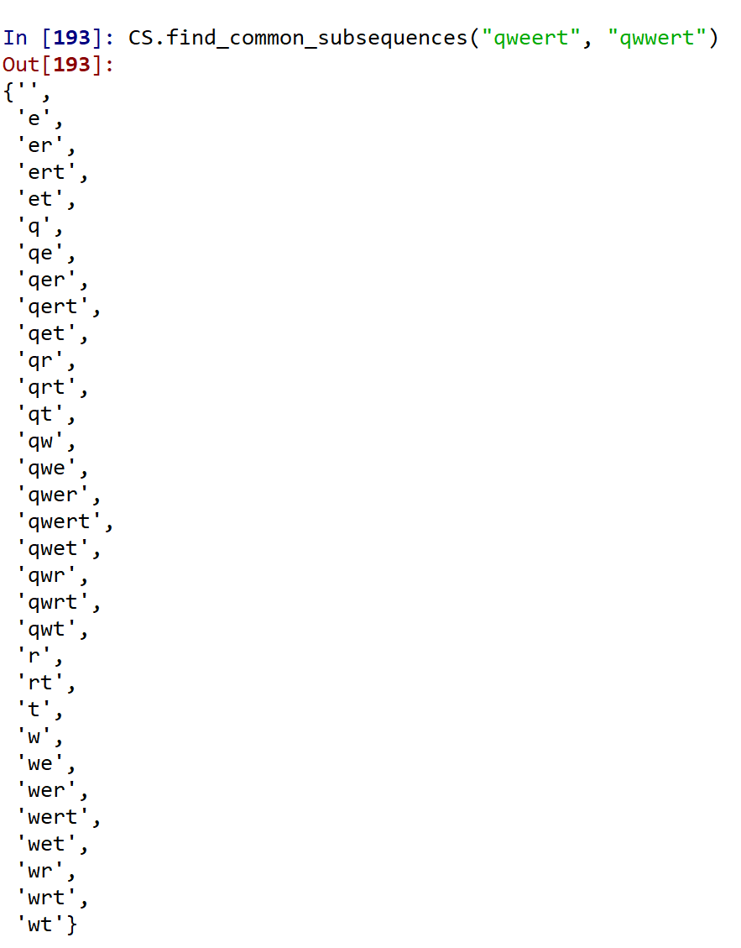
Correction: Statistical Learning Model (Cont.)
LCS: Longest Common Subsequence

Slide 11
Challenges
Creating the error-truth pairs

Slide 13
Evaluation

